Slide 1


Public Government:
IPv6 Take off Monitoring
Jiří Průša (CZ.NIC Association), Frankfurt, 23 May 2014
Notes:
Jirko, nevim, z ceho mas ten titulek, ale u ‘Off’ bych napsala velke ‘O’

Slide 2
How to measure IPv6 adoption?
  Based on the IPv6 connectivity
  (Google users)
  IPv6 readiness of web-servers,
  DNS and mail servers
  (Alexa, GEN6)

Slide 3
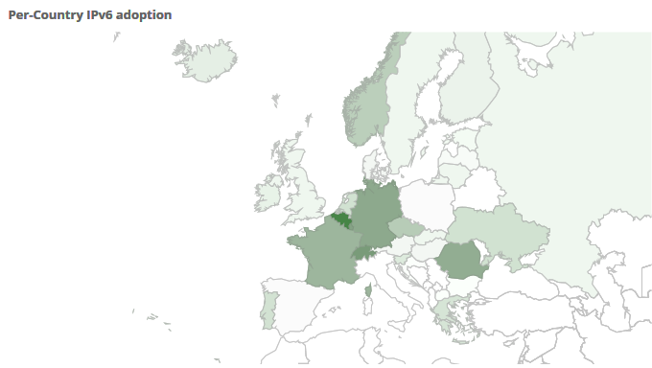
Google stats
Norway;
2,15 %
Germany;
8,04%
Belgium;
16,66%
Czech Republic;
3,46 %
Luxembourg;
7,87%
Romania;
5,63%
France;
4,93%
Switzerland;
10,90%
Notes:
Vymazala bych ty stredniky

Slide 4
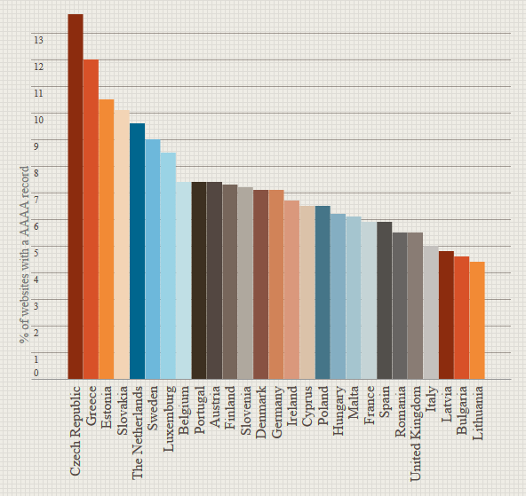

IPv6 Observatory
www.ipv6observatory.eu

Slide 5
Introduction: IPv6 Government benchmarking
  Digital Agenda for Europe, Action 89: eGovernment services supporting IPv6
  Based on the pilot project in the Czech Republic, IPv6 readiness benchmarking is expanding by GEN6 to other countries.
  In order to compare the comparable, the methodology for collecting URLs was set up.
  Benchmarking involves government institutions only, at all levels:
    National: ministries, legislative bodies, judicial authorities…
    Regional: representatives of regions (only in some countries)
    Local: largest cities in each country
  Data available for: the Czech Republic, Estonia, Germany, Greece, Luxembourg, the Netherlands, Slovenia, Slovakia, Spain and Turkey.

Slide 6
IPv6 Government benchmarking
  2 407 websites analysed
  400 national level
  137 regional level
  1870 local level
Notes:
Jirko, nekde mas stredniky, nekde carky – misto stredniku bych dala carky

Slide 7
IPv6: Government benchmarking
■ WWW
■ DNS servers
■ Mail servers

Slide 8
Government benchmarking: National Level
■ WWW
■ DNS servers
■ Mail servers

Slide 9
IPv6 Government Policies in the Czech Republic
8 June 2009 : Government Resolution on IPv6
IPv6 in public tenders on network infrastructure components (30/6/2009)
Ensure availability of government websites via IPv4 and IPv6 (1/1/2011)
20 March 2012 : Digital Czech 2.0 Strategy
Wider government support for IPv6 deployment
Government policy for DNSSEC support
Internet Governance rules: preferring self-regulation
18 December 2013 : Government Resolution on DNSSEC & IPv6
IPv6 and DNSSEC in all relevant public tenders (1/1/2014)
Availability of mail servers via IPv6 (1/3/2015)
19 December 2013 : Guidelines for data traffic management
National telecom regulator declared IPv6 as a part of net-neutrality
IPv6 = net neutrality!

Slide 10
Government benchmarking: Local Level
■ WWW
■ DNS servers
■ Mail servers

Slide 11
Government benchmarking: Regional Level
■ WWW
■ DNS servers
■ Mail servers

Slide 12
IPv6 Deployment in Germany
 | WWW |  | DNS |  | E-mail
 | 1/13 | 5/14 | 1/13 | 5/14 | 1/13 | 5/14
Central gov. institutions | 0 % | 0 % | 35 % | 39 % | 0 % | 0 %
Bundesländern | 13 % | 13 % | 37 % | 37 % | 6 % | 6 %
Cities | 6 % | 6 % | 33 % | 41 % | 1 % | 6 %
  From the service point of view, the highest IPv6 deployment is recorded by name servers. Its probably due to name servers operators, especially data centers.
  (Regional) data centers also play an important role in IPv6 transition by cities – 10 new municipalities started to support IPv6 on their webservers, 76 on name servers and 26 on mail servers.

Slide 13

IPv6 Deployment in Germany
Von Arnsberg zum Zweibrücken

Slide 14
IPv6 Deployment in the Czech Republic
 | WWW |  | DNS |  | E-mail
 | 1/13 | 5/14 | 1/13 | 5/14 | 1/13 | 5/14
Central gov. institutions | 19 % | 45 % | 55 % | 87 % | 19 % | 36 %
Regional Governments | 8 % | 15 % | 54 % | 85 % | 15 % | 23 %
Cities | 8 % | 32 % | 39 % | 64 % | 2 % | 10 %
Average in .cz domain | 15 % | 21 % | 51 % | 57 % | 13 % | 15 %
  Legislation has the power to support IPv6 deployment – institutions affected by government resolution have more than twice higher IPv6 support by web-servers than is the national average. The IPv6 deployment by public administration is quicker by public administration.
  Involvement of IPv6 criterion in various „the best website“ competitions has similar effect with minimum effort!

Slide 15

Conclusions
  Although there are no free IPv4 address blocks in Europe, IPv6 deployment is still very low, both within the public administration and business!
Contact
jiri.prusa@nic.cz

